Slide 1

Expanding the Tiered Framework: Site-Specific Numerical Sediment Standards
Presenters: Wayne Landis, Jasen Nelson,
Facilitators: Jennifer Trowell, Geoff Wickstrom, Marc Cameron, Shannon Bard
Science Advisory Board for Contaminated Sites in BC
Science and Standards Technical Advisory Committee
Notes:
Welcome to our interactive discussion on developing a tiered framework for sediment standards. As facilitators from the Sediment Science and Technical Advisory Committee (SSTAC), we're excited to gather your valuable input on this critical topic within the Sediment Management track at CEW 2025. This presentation will explore how we can create a more flexible, scientifically robust approach to sediment assessment in British Columbia's diverse aquatic environments.

Slide 2

Why a Tiered Framework for BC Sediment Management?
Current Limitations
Adaptable Approach
Enhanced Protection
Generic numerical sediment standards are fixed concentrations without consideration of environmental factors affecting exposure and toxicity, resulting in high uncertainty, and conservative or under-protective assessments.
Site-Specific Sediment Standards as a Tier 2 option, based on site conditions and not conservative assumptions, reduces uncertainty and streamlines assessment/remediation. Protocol 2 procedure and model.
Supports site-specific and risk-based decision-making, leading to better environmental outcomes and more effective resource allocation.

Slide 3
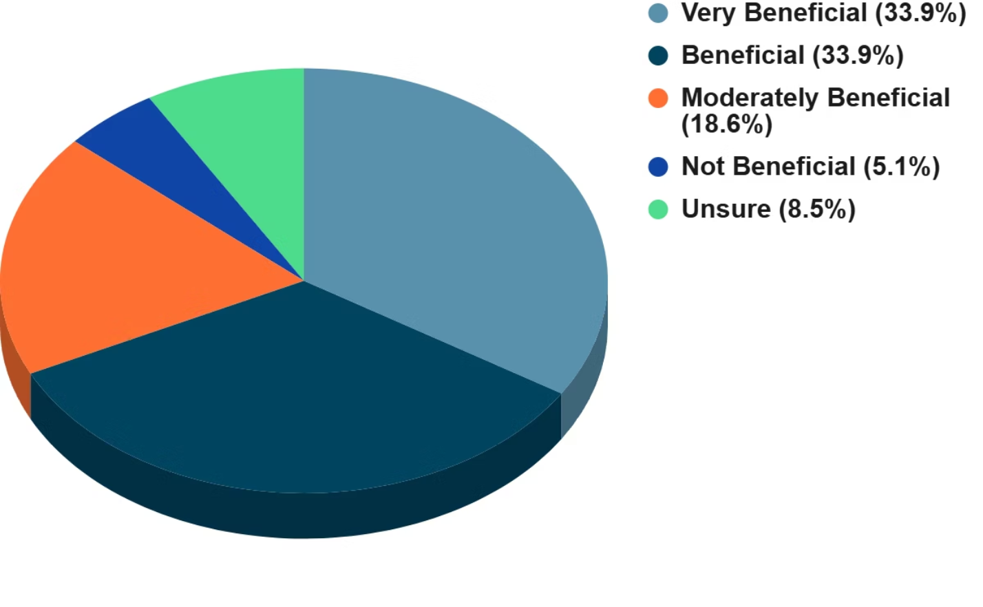
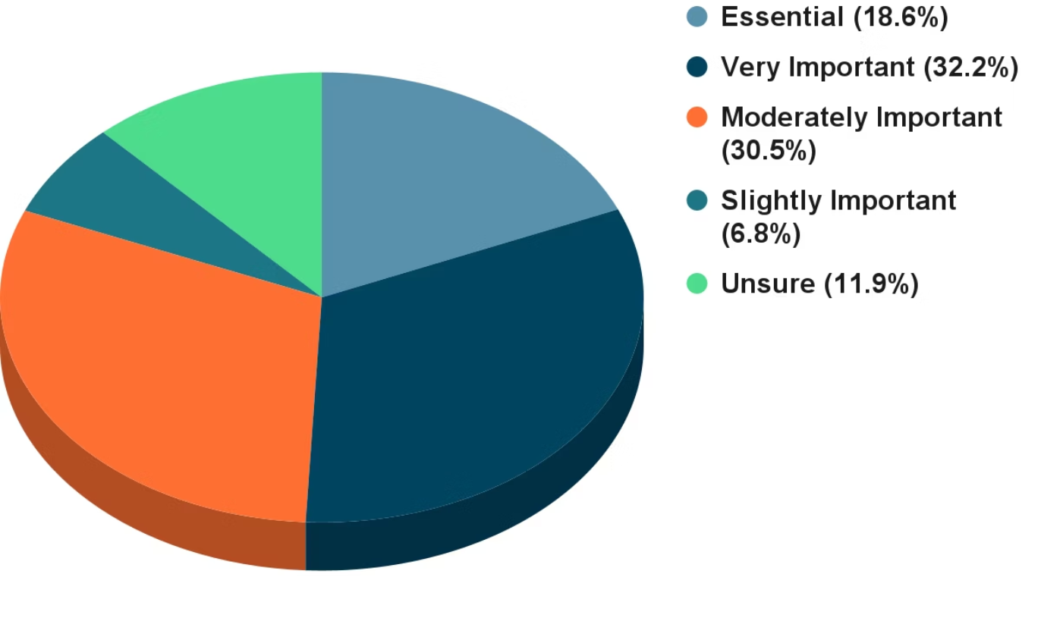
Key Messages from Survey: Site-Specific Standards & Tiered Framework
86.4%
88.1%
Tiered Framework Beneficial for Future Sediment Standards Framework
Importance of Bioavailability adjustments for Sediment Standards Framework in Future
"Exceeding a standard for a particular substance is almost irrelevant without the context of bioavailability (eg. AVS/SEM, organic carbon)"
"The bioavailability in sediment helps us understand not just how much contaminant is present, but whether it is causing harm or influencing environmental processes. This distinction is required to make informed decisions in managing contaminated sites"

Slide 4





Proposed Three-Tier Framework for Sediment Assessment
Tier 1: Screening Level Numerical Assessment
Conservative, generic standards for initial site characterization. Quick identification of sites needing further assessment.
Tier 2a: Refined Numerical Assessment
Follow procedures and use models (e.g., Cause-Effect) in Protocol 2 to derive site-specific sediment standards, predominantly for bioavailability adjustments.
Tier 2b: Screening-Level Risk-Based Assessment
Similar to Tier 2a, with an additional option for using prescribed lines of evidence such as community analysis as part of habitat assessment (Protocols 2 & 13).
Tier 3: Detailed Risk-Based Assessment
Detailed risk assessment using site-specific factors and multiple lines of evidence such as community analysis (Protocols 1 & 20).

Slide 5

Scientific Approaches for Bioavailability Adjustment
In developing Protocol 2 requirements, procedures, and a supporting model for bioavailability adjustments, would a cause-effect model (e.g., Bayesian Networks or Regression) be the best approach for a scientific framework that uses site-specific data and known toxicity-modifying factors to develop refined sediment standards?
(60s response + 60s results)
Yes
No
It depends
Unsure
Other

Slide 6

Integrating Lines of Evidence
Please rank the following lines of evidence in order of importance for developing a robust scientific framework for deriving Tier 2b site-specific sediment standards for screening-level risk assessment (1 = most important).
Note: Assume that professional judgment is limited to development of the framework, not implementation, since this is intended to support an enhanced numerical screening process, not risk assessment. Clear discretization thresholds and weights would be included in the framework. (60s response + 60s results)
Environmental Conditions: Physical and chemical data
Quantitative analysis of well understood physical and chemical parameters that affect bioavailability (e.g., grain size, TOC, pH, SEM/AVS).
Bioaccumulation Data in Tissues of Local Species
Laboratory or field tests measure actual tissue concentrations of organisms exposed to sediment contaminants.
Benthic Community Structure Analysis
Assessment of in-situ organism populations reveals real-world ecological impacts and community-level effects of contamination.
Other

Slide 7




Your Input: Guiding the Tiered Framework
Today's Discussion
Scoping Plan
Your expertise will directly aid the development of scientifically defensible and practical standards for ecological protection
Roadmap for future research to support the collaborative development of a modern framework for sediment standards
SSTAC White Paper
High-level summary of the Sediment Standards Project (Phase 1), including a synthesis of your input

Slide 8



Thank You!
Your Contributions Matter
Your expertise is vital as we work to modernize BC's sediment standards for comprehensive ecosystem protection.
Protecting Our Aquatic Ecosystems
Together, we're developing standards that safeguard aquatic ecological organisms and the predators that depend on them.
Contact SSTAC
For questions or additional input, please reach out to us. We appreciate your engagement in this important work.

